Slide 1
The Community Perspective women living with HIV from Africa
Jacque Wambui
AfroCAB Representative
IAS 2019

Slide 2
The Community Perspective women living with HIV from Africa
Jacque Wambui
AfroCAB Representative- Kenya
IAS 2019
@jcqwambui
Share your thoughts on this presentation with #IAS2019

Slide 3

WOMEN’s Access to ART
WLHIV across Africa since last May were denied access to a drug, which had been advocated for by Treatment Activists, without their consultation and denying them CHOICE!

Slide 4
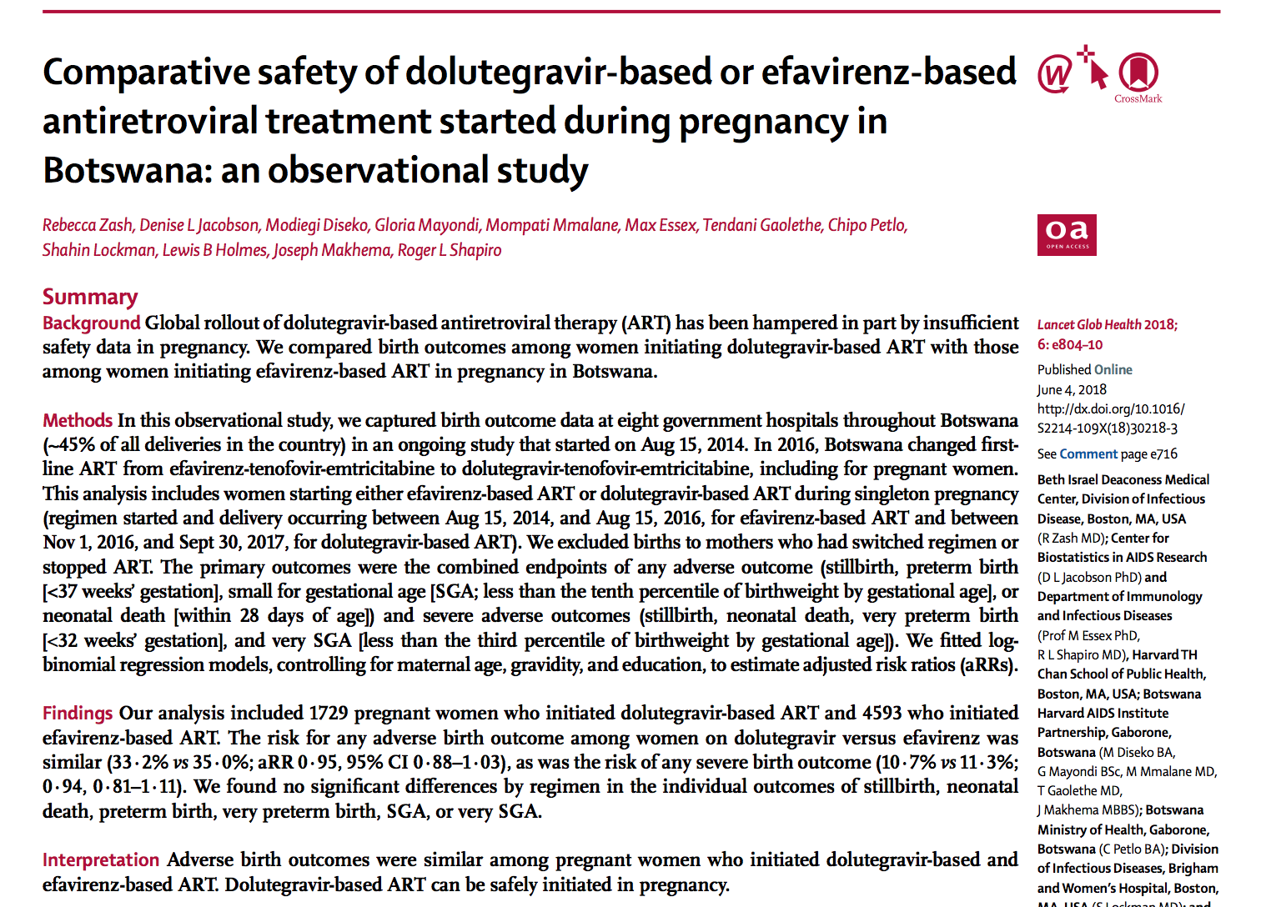
Background: Women, Dolutegravir, and the Community
Botswana Tsepamo study interim results indicated a potential link between neural tube defects (NTD) and dolutegravir (DTG) use at the time of conception.
Global and national stakeholders reacted quickly to the safety signal. The messages and directives in the responses varied, but they all have one thread in common: limited to no community consultation.
This means that the global community did not consult the primary population affected by these findings, the women living with HIV, in regards to their own health care decisions.

Slide 5
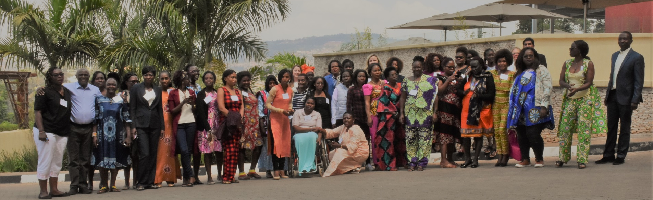
Women Taking a stand: Kigali Meeting
AfroCAB organized a meeting of 39 women living with HIV representing 18 countries in Kigali, Rwanda on July 13 and 14, 2019 to discuss the potential NTD safety signal and develop a joint position on behalf of women for access to optimal HIV treatment and prevention.

Slide 6
Discussion at the Kigali Meeting
Potential risk similar to the other ARV treatments that are currently available to us. [I.e., NTD is not the only risk of ART]
We are diverse – not all women seek to have children.
We can make decisions about our reproductive health.
We are disappointed at our lack of involvement in decision making in regards to our treatment access.
We believe that, with correct information and contraceptive access, we can make informed choices in using DTG and planning our pregnancy.
This is an opportunity for integrating much-needed access to contraceptives within HIV treatment in order to achieve universal reproductive health care for all.
1
5
2
3
6
4

Slide 7
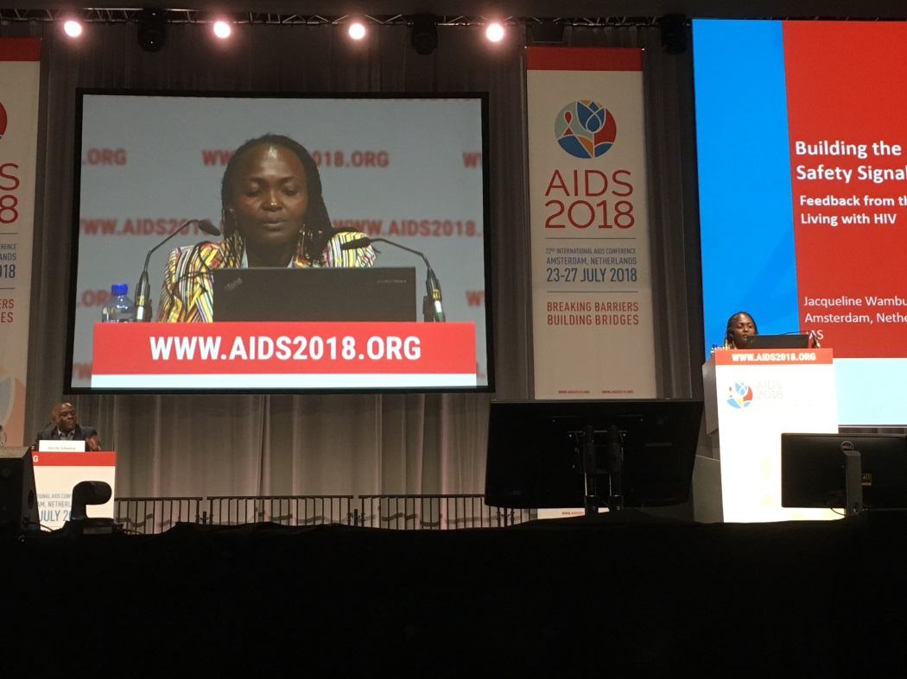
Joint Position from Kigali Shared at IAS 2018
“We believe it is critical to not just view a pregnant woman, or any woman of childbearing potential, as a vessel for a baby, but as an individual in her own right, who deserves access to the very best, evidence-based treatment available and the right to be adequately informed to make a choice that she feels is best for her.”
Presenting the joint position statement at IAS 2018

Slide 8

Outcomes of the Kigali Meeting
Unanimous decision based on the data currently available that DTG’s benefits – reduced side effects, improved efficacy, and a high barrier to resistance – outweigh its potential risks.
Concluded that blanket exclusions that deny women equitable access to this optimal HIV treatment are not warranted or justified.
“We are calling for TLD to be made available urgently across Africa, with everyone having access, regardless of gender or reproductive capability, and with integration of sexual and reproductive health services.”

Slide 9
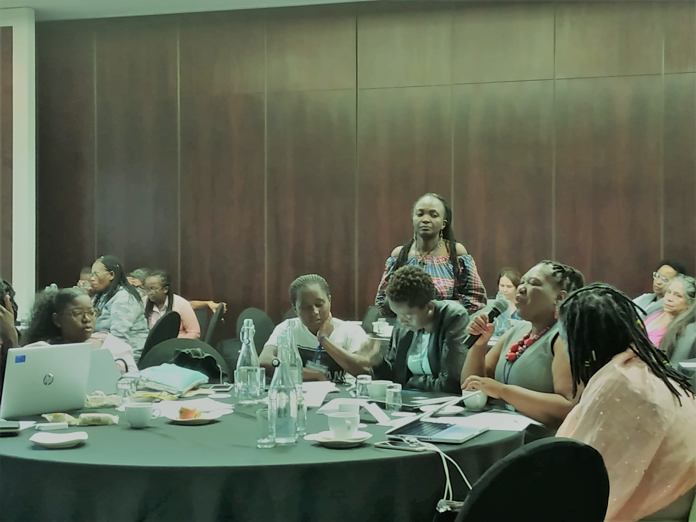
The Kigali Meeting Led to Productive Engagement AT IAS London Forum & RSA Global
Meeting with WHO Directorate to present joint position statement on behalf of women living with HIV, which influenced global and national guidelines, including a women-centric approach.
The IAS London Forum held in September 2018, and the follow up in November 2018, discussed a framework for evaluating and introducing new ART regimens into the general adult population to ensure collection of appropriate data to inform safety of drug use in women of childbearing potential and to hopefully avoid the current level of uncertainty regarding periconception DTG ART use and NTD risk.
The Community Consultation on Response to the Risk of Preconception DTG Exposure held in November 2018 brought together women living with HIV from twenty PEPFAR supported countries in Johannesburg, South Africa.

Slide 10





Examples of How to Engage the Community
Creating a community advisory board: Leveraging already strong community networks, AfroCAB, CHAI, Unitaid, and HIV i-base created a treatment Community Advisory Board (CAB) to bring civil society’s voice to the center of the treatment optimization agenda
Including community in national policy forums: In 2019, Zimbabwe invited women living with HIV to participate in community dialogues and HIV community advocates to present findings and participate in decision-making forums concerning access to DTG
Inviting community to participate in steering committees for research: Community members served on the Global Community Advisory Group and ECHO trial steering committee
Increasing community participation in global policy forums: In 2019, more community members participated in the WHO Guidelines Development Group for HIV Treatment
HIV Treatment Literacy Materials: Radio programs and diverse sets of treatment literacy materials, including pamphlets, brochures, pocket guides, videos, and training manuals, help increase awareness and understanding of new, optimal products and generate demand.

Slide 11
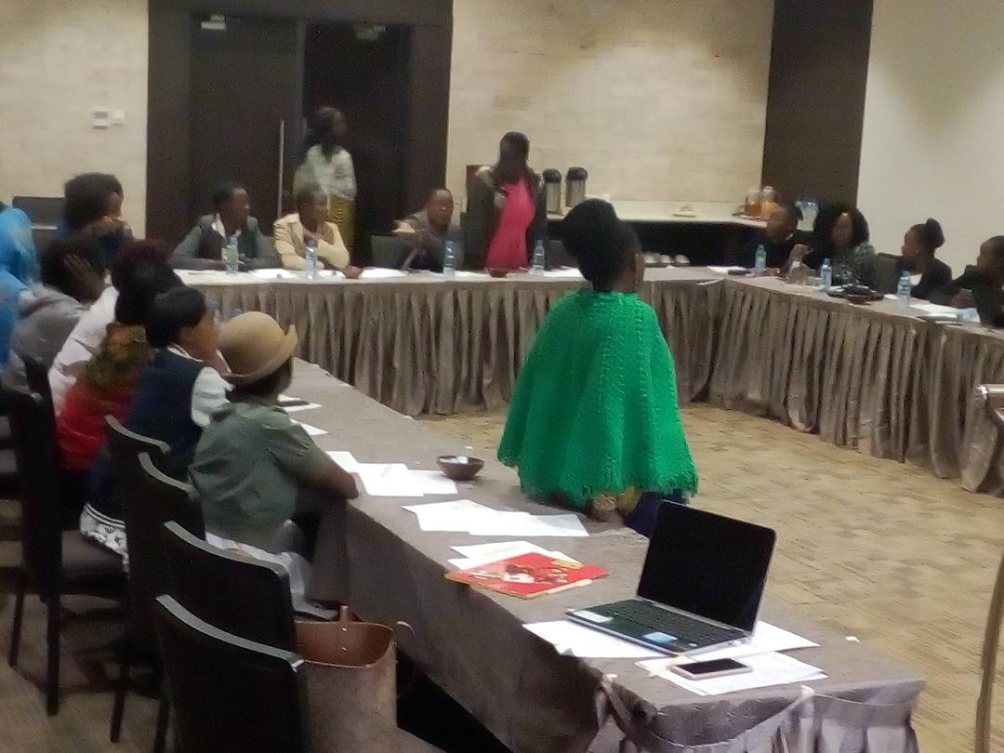
Deep Dive On Engagement: Kenya
Facilitated three community consultations to discuss access to DTG in Kenya among women of childbearing age following the potential neural tube defect (NTD) safety signal for DTG.
Following the first meeting, participants organized a one-on-one meeting with the head of the MOH and wrote a petition to disseminate the recommendations.
The other two consultations were held after the release of the national guidelines and aimed to further understand the experiences, barriers, and challenges women face in accessing DTG and family planning services at facilities.

Slide 12
Key Takeaways and Lessons Learned From DTG
The community’s unified voice that advocated for equitable access and patient choice in DTG rollout defined the global conversation and shifted country responses to the safety alert:
The Community Voice Should Be Elevated in National Policy Decisions: Involving community early, such as holding consultative meetings with women of childbearing potential, can help develop consensus on access to treatment and can inform national guidelines and rollout planning.
01
There Is An Unmet Need for Contraceptives for Women Living With HIV: Globally, unmet contraceptive need is heavily concentrated in sub-Saharan Africa, where HIV prevalence is also high. By integrating family planning services with HIV services, there is an opportunity to increase DTG access to women.
02

Slide 13
Moving Forward
Offering comprehensive, women-centered care is much broader than the DTG safety signal and we should maintain momentum going forward.
WLHIV & AGYW disproportionally lack access to information & services to control timing and # of pregnancies, protect themselves from HIV & STIs, and make decisions regarding their own healthcare
49%
26%
8x
#1
5-7 years
AGYW accounted for 26% of new HIV infections but only 10% of the population. (Open AIDS J. 2016;10:34–48)
HIV prevalence among AGYW is up to 8x that of their male pears (Open AIDS J. 2016;10:34–48)
  Childbirth is the leading cause of death globally for girls age 15-19 (WHO; 2016.)
Young women will acquire HIV five to seven years earlier than their male peers (JIAS 18(Supplement 1):19408)
WLHIV whose last pregnancy was unintended (PEPFAR-PROMOTE cohort study, 2018)
Notes:
Jacque – this is where I would mention the story about the women you sent me via email about her on DTG and the abortion

Slide 14
WLHIV HAVE DISTINCT CLINICAL & SERVICE DELIVERY NEEDS THAT D BE ADDRESSED THROUGH A MORE INTEGRATED APPROACH
Require counseling on prenatal care specific to ART.
Many ARVs interact with hormonal contraception, potentially decreasing contraceptive effectiveness. Women should be fully informed of this potential risk and their full range of ART and contraception options. Initial experiences with SRH/HIV integration training in countries suggest that ART providers are not familiar with these interactions – suggesting that WLHIV are getting incomplete counseling and are at risk for ‘breakthrough’ pregnancies.
Should be supported to prevent unintended pregnancies as a key PMTCT strategy, or supported to have a healthy and safe pregnancy, in line with a woman-centered approach.
Are at elevated risk of mortality related to pregnancy / childbearing. ^{1, 2}
Preventing unwanted pregnancy is especially important among WLHIV and AGYW, for whom pregnancy is more risky. If childbearing is desired, WLHIV and AGYW should be provided with comprehensive information and care that enables them to have safe and healthy pregnancies.
Face stigma & discrimination among HCWs; highly value privacy
WLHIV often fear disclosing their status at FP clinics; bringing these services to them within the ART site makes them more accessible.
Conservative social norms around sexual activity outside of marriage and can discourage AGYW from seeking services.
¹Zaba et al, SSA pooled data from 1989-2012; ²(WHO; 2016.)
Notes:
NAMRATA

Slide 15


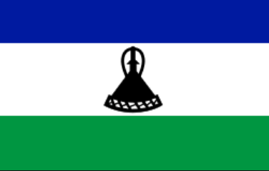


COUNTRIES HAVE TAKEN STEPS TOWARDS SRH/HIV INTEGRATION – BUT MORE PROGRESS IS NEEDED
To achieve the gold-standard ‘one-stop shop’ service delivery, actions are needed across domains including national policy, training, and supply chain
National working groups related to HIV and/or reproductive health should include representatives from across government departments
Zambia has added reproductive health dep’t staff to TLD Introduction Steering Committee
Clear responsibility for SRH service provision should be assigned to ART site staff through national guidelines or other official guidance
Cambodia HIV treatment guidelines include family planning as a responsibility of the ART site, and ART sites have the mandate to provide pills and injectables
Training on comprehensive SRH service provision for ART staff should be integrated into TLD introduction training and other in-service ART training
Lesotho, Uganda, and a number of other countries are including SRH services in TLD training curricula
Gaps / bottlenecks in the contraception supply chain should be addressed to ensure regular, rational delivery of commodities to ART site pharmacies
Eswatini is working to address equipment availability to enable all SRH services to be provided in ART room
Notes:
NAMRATA

Slide 16

Thank you!
Acknowledgments:
This work is made possible by the generous support and partnership of Unitaid

